Slide 1
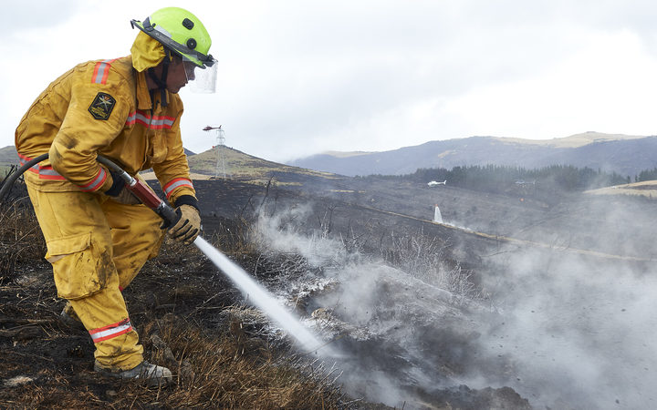
การทำความเข้าใจและการใช้งานโฟมประเภท A (Class A Foam)
แดน เนสบิต
หน่วยกู้ภัยดับเพลิงด่วน | เจ้าหน้าที่สถานีอาวุโส (Senior Station Officer), หน่วยดับเพลิงและฉุกเฉินนิวซีแลนด์ (Fire and Emergency NZ)

Slide 2
บทนำ
เจ้าหน้าที่สถานีอาวุโส (Senior Station Officer) ผู้มีประสบการณ์อย่างกว้างขวางด้านการดับไฟป่าและไฟโครงสร้าง พร้อมคุณวุฒิเป็นช่างเทคนิคการค้นหาและกู้ภัยในเขตเมืองระดับ NZL1 (Urban Search & Rescue – USAR)
มีประสบการณ์ใช้งานโฟมประเภท A (Class A Foam) มานานกว่าสิบปีในหลากหลายสภาพแวดล้อม

Slide 3
Today’s Goal
Share insights on the safe, effective, and practical use of Class A foam
Class A foam is not always well understood – let's simplify it

Slide 4
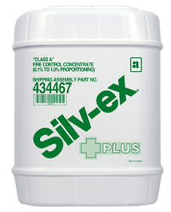
โฟมประเภท A คืออะไร?
สารเติมแต่งที่มีพื้นฐานจากสารลดแรงตึงผิว ซึ่งช่วยลดแรงตึงผิวของน้ำ
ช่วยให้น้ำซึมลึกเข้าสู่วัสดุประเภท A เช่น ไม้ กระดาษ พืช ถ่านหิน ยาง
ไม่เหมือนกับโฟมประเภท B
ช่วยเพิ่มประสิทธิภาพของน้ำและเสริมประสิทธิภาพในการดับเพลิง
โดยทั่วไปจะผสมในอัตรา 0.1%–1% ขึ้นอยู่กับภารกิจและอุปกรณ์ที่ใช้
เป็นมิตรกับสิ่งแวดล้อม – ไม่มี PFOS / PFOA
Notes:
Class-A Foam is specifically designed to combat fires involving ordinary combustible materials (Class A Fires) such as paper, tires, and wooden structures, as well as wildland. The concentrate reduces the surface tension of water providing superior wetting and penetrating characteristics. This allows the solution to penetrate into the char of deep-seated fires, promoting cooling and making the Class-A fuel less combustible. We usually mix it anywhere between 0.1% and 1%, depending on the job. Lower for mop-up and vegetation fires, higher when we need more cling or barrier — like in exposure protection.”
PFAS chemicals are not necessary to give Class-A foams these properties in these types of fires therefore Class-A Foam can be produced without using any type of environmentally harmful chemicals
Class A foam lowers the surface tension of water, allowing it to penetrate materials and extinguish fires faster. Class B foam creates a barrier between fuel and oxygen, suppressing vapors and preventing reignition
NOT suitable for use on any fuel with an appreciable water solubility (polar solvents) such as methyl and ethyl alcohol, acetone, and methyl ethyl ketone

Slide 5
ทำไมจึงใช้โฟมประเภท A?
ช่วยให้น้ำซึมลึกเข้าสู่วัสดุเชื้อเพลิงที่กำลังลุกไหม้
เร่งการดับไฟและลดปริมาณการใช้น้ำ
ช่วยป้องกันการลุกไหม้ซ้ำโดยการทำความเย็นและซึมลึกลงไป
ปลอดภัยต่อสิ่งแวดล้อมมากกว่าทางเลือกหลายชนิด
ลดความเหนื่อยล้าของเจ้าหน้าที่ดับเพลิง เพิ่มประสิทธิภาพและความปลอดภัย
Notes:
Class A foam improves how water behaves on a fireground. First off, it helps water soak into fuels more effectively — that means deeper penetration into things like timber, scrub, mulch and deep-seated structure fires – upto 3-5x more effective than water
That better penetration leads to faster knockdown, and we end up using a lot less water to achieve the same result — especially useful in rural areas with limited water supplies
It also helps with preventing rekindles. By soaking deeper and cooling the material more completely, there’s less chance of reignition during mop-up.
From an environmental point of view, the foams we use are fluorine-free and biodegradable. That makes them much safer alternatives to older foam technologies.
And overall, it just makes our jobs more efficient. Shorter time on scene, less water to cart around, and less fatigue for the crew.
Foam doesn’t replace tactics — but when used well, it enhances everything we do.”

Slide 6
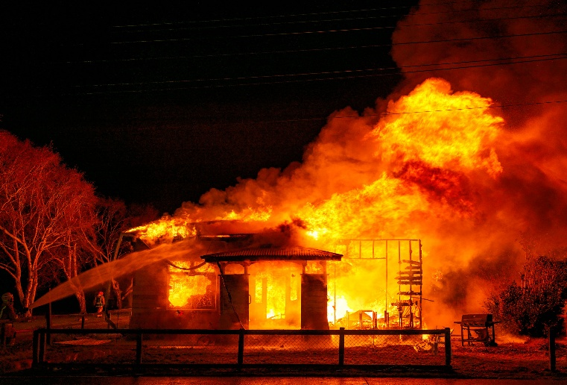
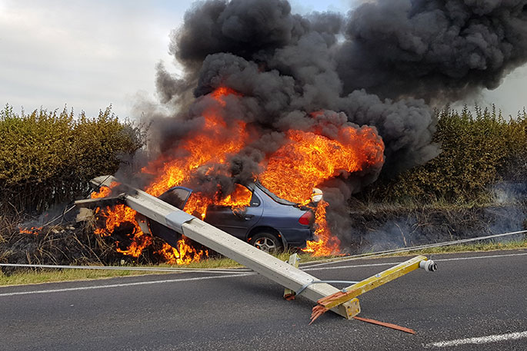
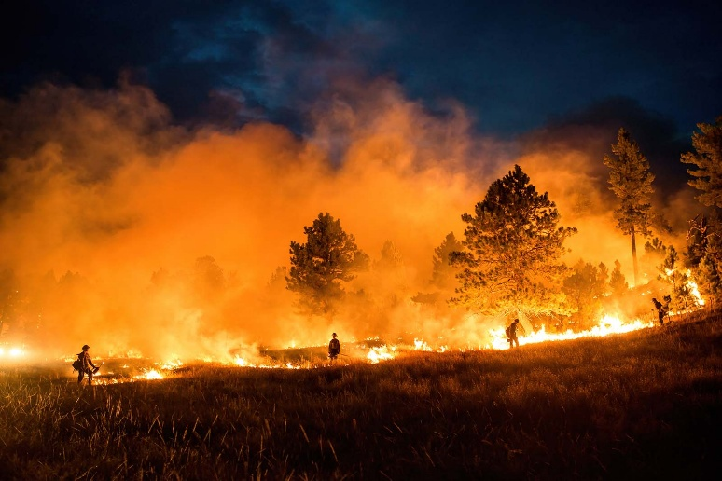
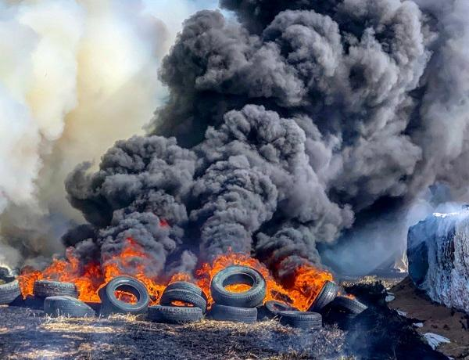
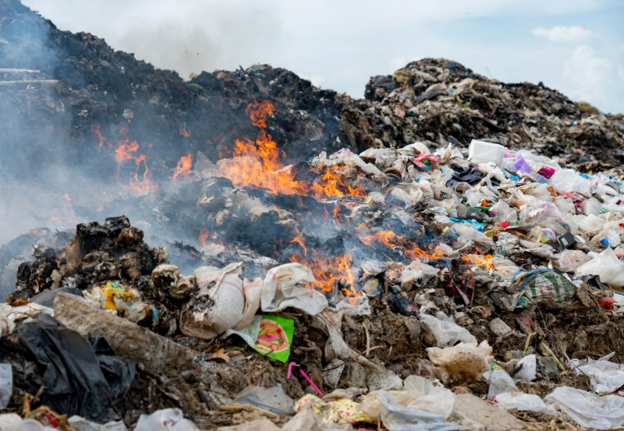
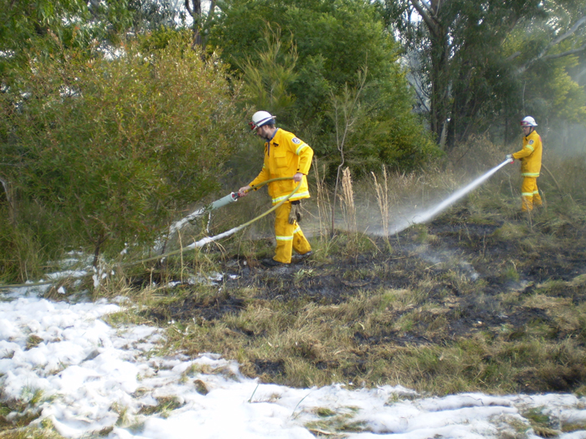
Class-A is Effective On...
Notes:
Structure Fire
In structure fires, especially in timber-framed homes or roof voids, Class A foam improves water’s ability to soak into structural materials. It clings to surfaces, helping prevent rekindle and reducing mop-up time.
Vehicle Fire
Vehicle fires often include plastics, upholstery, and rubber – all of which are Class A fuel types. Foam gets into tight compartments and helps knock down the fire faster than plain water.
Wildfire
This is where most people already associate Class A foam. It’s excellent on grass, scrub, and forest fires. You can apply it as a wet line to stop spread, or coat vegetation to protect exposures ahead of the fire front.
Tyre Fire
Tyre fires are notoriously difficult because they burn hot, deep, and for long periods. Class A foam helps cool the fire, cling to the rubber, and penetrate into the stacked material where water would usually run off.
Skip Bin
Skip bin or rubbish pile fires contain deep-seated combustibles and a mix of fuels. Class A foam soaks into the pile, reducing reignition risk and making overhaul much faster and more effective.
Wet Line Protection
Here we’re using Class A foam proactively—laying down a foam line to stop the spread of fire or to protect exposures. It clings to surfaces and holds moisture far longer than plain water.
The key takeaway here is that Class A foam enhances how we use water. It doesn’t replace tactics, but it makes water more efficient across a wide range of fire scenarios.”

Slide 7
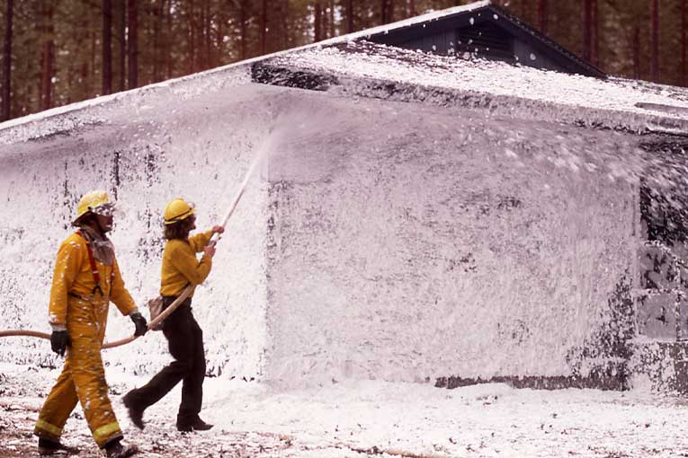
วิธีการใช้งานทั่วไป
Direct attack
Indirect attack
Mop-up
Exposure protection
* การผสมสารเติมแต่งแบบอินไลน์ (Inline Induction),
การผสมสารเติมแต่งรอบปั๊ม (Round the Pump Induction),
ระบบโฟมอัดอากาศ (Compressed Air Foam System - CAFS)
Notes:
Direct Attack: 0.3% - 0.6% - There is no need to change the current method of attack, flow rate or equipment during a fire-fighting emergency. All that is required is to have the ability to inject the Class “A” foam concentrate into the water stream at the correct proportioning rate resulting in a noticeable decrease in extinguishment time. In many cases direct attack with an air-aspirating foam nozzle has been used. This nozzle gives a greater expansion to the discharging foam. Consequently, an increase in bubble size is experienced which in turn increases the surface area available to absorb heat.
Indirect Attack: 0.6% - 1% - This method of fire fighting calls for coating walls, roofs, etc., in front of the fire and allowing the fire to burn to the foam coated area. When the fire reaches the coated area, the Class “A” fuel has been soaked by the water draining from the foam and the flames are slowed by the foam mass. The soaking and the foam mass allow the fire to be controlled quickly.
Exposure Protection: 1% (aerated) - It is often necessary to protect surrounding structures with valuable water streams to prevent those structures from becoming involved in fire. A blanket of Class “A” foam will help in exposure protection.
Mop-up/Overhaul: 0.1% - 0.2% - Water has a high surface tension and tends to bead up and cause run off. During the overhaul/mop-up process, large quantities of untreated water must be used to ensure that complete extinguishment has been obtained. When water has been treated with a Class “A” foam concentrate, the wetting effectiveness is increased and gives the water a greater affinity for Class “A” materials (carbon). which allows the treated water to soak into the fuels far more rapidly. Class “A” foam concentrate allows a major reduction in the quantity of water used during the mop-up and overhaul.
“CAFS, or Compressed Air Foam System, is one of the most effective ways to deliver Class A foam on the fireground.
It works by mixing three elements—water, Class A foam concentrate, and compressed air—to create a finished foam that’s stable, dense, and highly effective. The result is a foam that clings to surfaces, penetrates deeply, and stays where you put it.
One of the key advantages of CAFS is its versatility. You can adjust it to produce wet foam for direct attack, or dry foam with a shaving cream consistency for exposures and fire breaks. It gives you more control over how the foam behaves in different tactical situations.
CAFS also extends your water supply—by introducing air into the stream, you get more volume and longer reach (less friction loss) while using less water. This is a huge benefit in rural or wildland settings where water supply is limited.
It’s particularly useful for structure protection, wildland-urban interface work, and rapid knockdown of deep-seated fires. But to get the full benefit, operators need training. Knowing how to dial in the correct mix and air ratio is key. Without that knowledge, you might just be pushing out watery suds or inconsistent foam.
Maintenance is also critical—CAFS systems need to be flushed and tested regularly to prevent clogs or imbalance.
Many modern fire appliances now include CAFS as standard, but the effectiveness still depends on crew familiarity and correct use.”

Slide 8
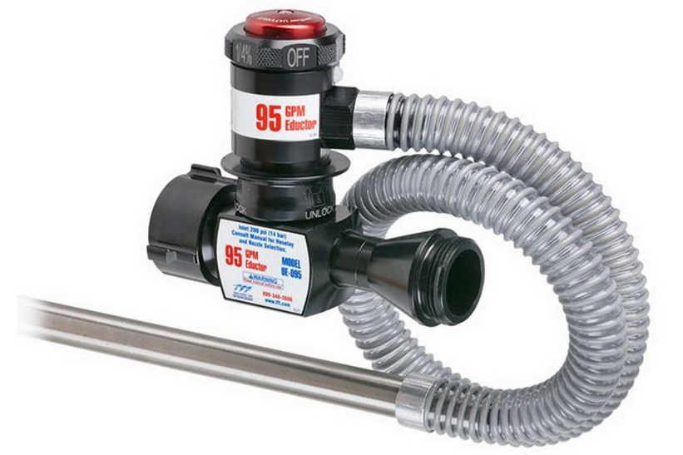
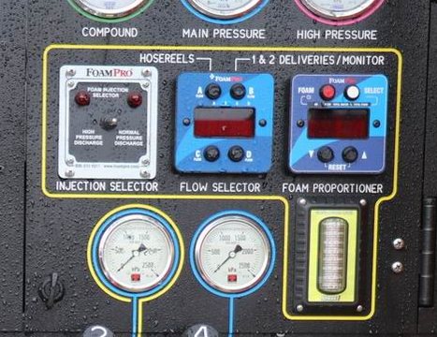
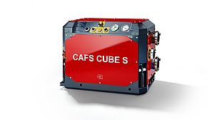
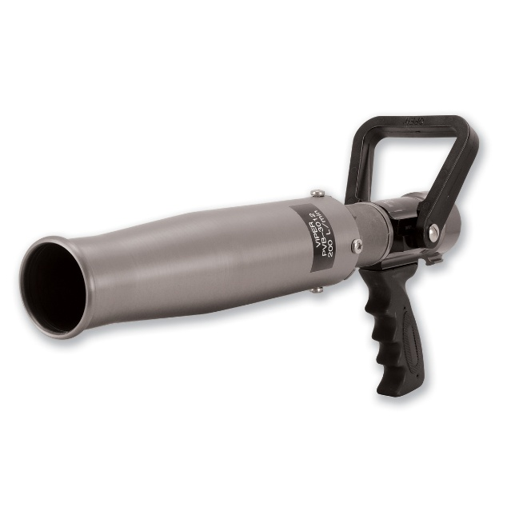
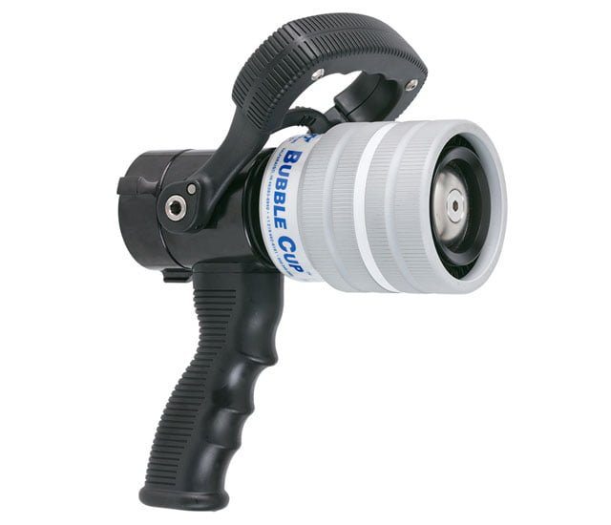
Application Equipment
Notes:
Inline Inductor (or Eductor)
“This is the most basic system — and it’s portable, simple, and effective when set up properly.
You connect the inductor directly into the hose lay, often between the pump and nozzle, and it draws foam concentrate from a container using the venturi effect.
It’s ideal for quick deployment and small incidents like scrub fires, tyre piles, or rural burns.
Limitations
You need the correct flow rate, pressure, hose lengths, and elevation — if you’re outside that sweet spot, the foam mix won’t be accurate. Also, it’s harder to adjust mix rates on the fly.”
Round-the-Pump Proportioning
“This is a built-in system found on many fire appliances. It works by diverting a portion of water from the discharge line through a venturi or metering valve, where it picks up foam concentrate, and then rejoins the main water stream.
It’s reliable, familiar to most crews, and great for structure or vegetation fires when you want to produce foam through multiple lines at once.
But it’s limited in that it can’t easily handle long hose lays or operate at high pressures — and like inline systems, it needs flushing after use to avoid buildup.”
Compressed Air Foam System (CAFS)
“CAFS takes foam to the next level. It mixes water, foam concentrate, and compressed air to produce finished foam — thick, clingy, and highly effective.
With CAFS, you can control the consistency — dry for exposure protection, wet for direct attack — and cover large areas with less water.
It extends your reach, reduces water usage, and produces excellent knockdown and soak-in capability.
The key here is training — if your crew doesn’t understand how to set air-to-solution ratios or the effects of foam quality, you won’t get the results you’re expecting. Plus, CAFS needs regular maintenance to keep it running.”
_______________________________________________________________________________________________________________
1. Inline Inductor (or Eductor)
Overview:
This is a portable device placed directly into the hose lay, typically between the pump and nozzle. It uses the Venturi effect to draw foam concentrate from a container (e.g., a drum or pail) into the water stream.
Best used for:
Quick-deployment situations
Small-scale vegetation fires
Remote or rural areas with limited appliance access
Pros:
Simple, lightweight, and doesn’t require built-in systems
Great for mobile or off-road setups (e.g., hose lays from tankers or portable pumps)
Inexpensive and easy to store
Cons:
Requires very specific flow rate and pressure to work correctly (typically 200–250 kPa / ~30–35 psi at nozzle)
Mix ratio is fixed and cannot be easily adjusted during use
Performance drops with long hose lays or elevation differences
Must be flushed after use to prevent blockages or residue buildup
Speaker Tip:
“If you’re off the mark on pressure or hose layout, the inductor won’t draw foam properly — and you’ll end up with water instead of foam.”
2. Round-the-Pump Proportioning
Overview:
This is a built-in system on many fire appliances. It diverts water from the pump discharge, mixes it with foam concentrate through a venturi or metering valve, and returns it to the main pump outlet line.
Best used for:
Structure fires
Wildland/urban interface
Incidents requiring multiple foam-capable hose lines
Pros:
Built into many urban/wildland fire appliances
Allows for multiple foam lines at once
Adjustable metering in many systems (e.g., 0.3%, 0.5%, 1%)
Familiar to most crews, easy to train with
Cons:
Doesn’t perform well over long hose lays or uphill gradients
Can’t operate at high pump pressures without loss of foam effectiveness
Like inline systems, it must be flushed after use
Some models don’t allow easy switch between Class A and Class B foam without flushing tanks
Speaker Tip:
“Round-the-pump works best when you’re staying relatively close to the appliance — like a structure fire or grass fire with short attack lines.”
3. Compressed Air Foam System (CAFS)
Overview:
CAFS injects compressed air into a water and foam mix to produce finished foam inside the appliance. It generates thick, consistent foam with strong cling, penetration, and insulation properties.
Best used for:
Structure fires (interior and exterior attack)
Exposure protection
Wildland fires (especially defensive lines and mop-up)
Tyre, rubbish, and deep-seated fires
Areas with limited water supply
Pros:
Dramatically improves foam performance (clings, insulates, penetrates)
Reduces water use — increases operational efficiency
Allows for foam consistency control (dry/shaving cream vs wet)
Extends effective reach of hose lines
Great for vertical surfaces or overhead application
Cons:
Training-intensive — operators must understand how to set correct air/water/foam ratios
Can require more maintenance (air compressors, valves, foam delivery system)
Improper calibration can produce ineffective foam (too dry or too wet)
If the compressor fails, you’re back to water-only suppression
Speaker Tip:
“CAFS is like the high-performance option. If your crews are trained and the system is maintained, it’s one of the most efficient and effective ways to apply Class A foam — especially when water supply is tight.”
Summary Talking Point
“Each system has its place. Inline inductors are quick and dirty, great for rural fires when time is tight. Round-the-pump is the workhorse — reliable and versatile for most structure and vegetation calls. And CAFS is the scalpel — powerful, efficient, and precise, but it demands more from your people and equipment.

Slide 9
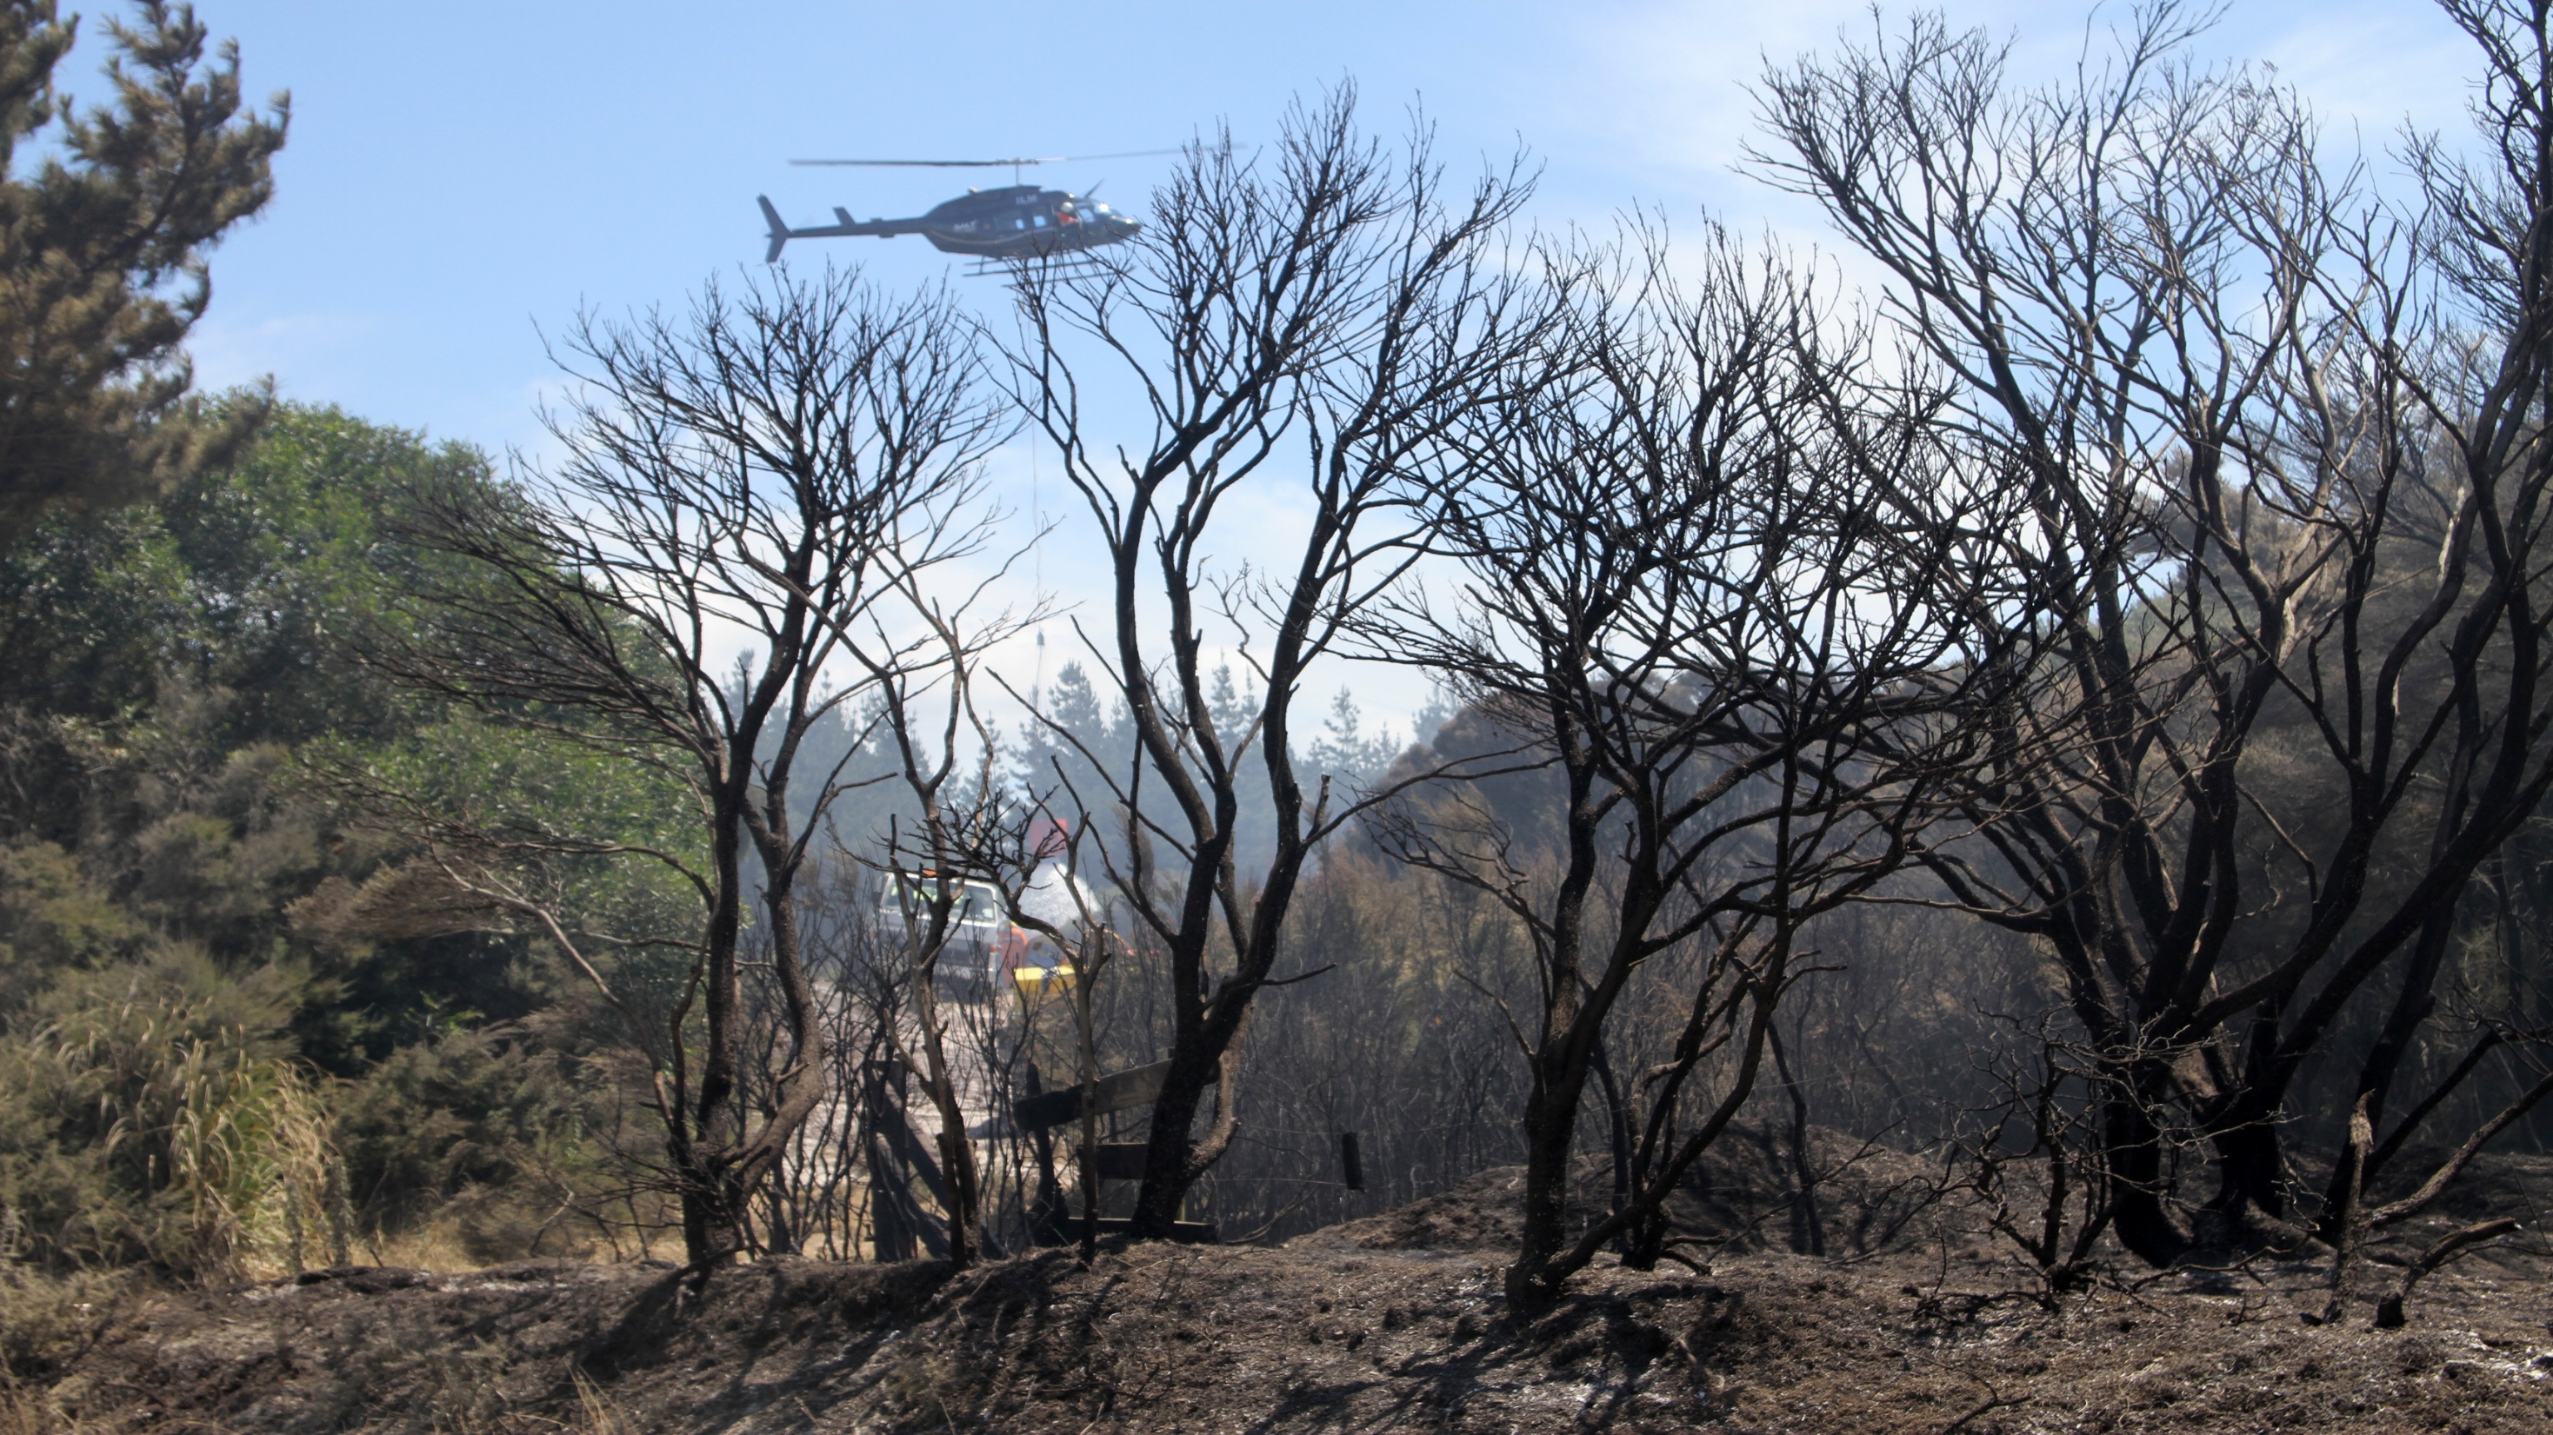
Notes:
“If you’re going to commit a helicopter to a vegetation fire, adding Class A foam to the monsoon bucket is a no-brainer.
Why? Because plain water dropped from height disperses quickly and often evaporates before it reaches deep into the fuel bed. But when we add Class A foam, we’re giving that water sticking power. The foam clings to the canopy, coats surfaces, and crucially — it penetrates into fuels far better than water alone.
That means every bucket drop is more effective. You get better knockdown, more cooling, and reduced reignition — especially on steep terrain or inaccessible areas where ground crews can’t immediately follow up.
In short, if you’re paying for aviation time, you want every drop to count — and Class A foam helps make that drop stick, soak, and suppress.”

Slide 10
การผสมและการกำหนดอัตราส่วน
อัตราส่วนผสมทั่วไป: 0.1% - 1%
หลีกเลี่ยงการผสมเข้มข้นเกินไป – เพราะจะทำให้โฟมเสียเปล่าและอาจก่อให้เกิดปัญหา
ตรวจสอบให้แน่ใจว่าเครื่องกำหนดอัตราส่วน (proportioners) และเครื่องผสมสารเติมแต่ง (e-ductors) ได้รับการปรับเทียบอย่างถูกต้อง
ล้างระบบหลังการใช้งานเพื่อป้องกันการสะสมและการกัดกร่อน
Notes:
“Over-concentration of Class A foam is something we want to avoid—not just for cost, but for safety and effectiveness.
When we exceed recommended mix ratios, the foam becomes thicker and harder to move through nozzles or CAFS systems. This can cause clogging and lead to poor foam quality, which in turn affects how well it sticks or penetrates fuel surfaces.
It also creates slippery surfaces on the fireground, adding a safety hazard.
Environmentally, while Class A foam is designed to be more benign than Class B, too much concentrate still increases the amount of surfactants entering the ecosystem. That can slow down biodegradation and affect soil and water health.
From a suppression standpoint, once we’ve lowered water’s surface tension enough to allow penetration, more foam doesn’t do more work—it actually starts to reduce effectiveness by insulating rather than cooling.
Finally, using more than necessary is just plain wasteful—it increases product use, cleanup time, and equipment wear with no added fire suppression benefit.
So the takeaway is: stick to manufacturer-recommended ratios. Calibrate your equipment and train crews to monitor mix rates, especially with proportioning systems like FoamPro or CAFS.”
Over concentration –
Foam clogging and buildup: Overly thick foam can cause buildup in lines, nozzles, and foam proportioning equipment (e.g. FoamPro, CAFS), especially if not flushed properly.
Inaccurate application: High-viscosity foam may not flow or aspirate properly through nozzles, affecting reach and coverage.
Reduced CAFS performance: In Compressed Air Foam Systems, too much concentrate can destabilize the foam, leading to poor-quality bubbles or “slurry-like” consistency.
Wasted product: Using more concentrate than needed significantly increases costs with no added suppression benefit beyond a certain point
Diminishing returns: Once surface tension is adequately reduced (~0.3–0.5%), adding more foam doesn’t improve penetration or extinguishing power. In fact, excess foam can create a slick or insulating barrier that inhibits water from reaching burning materials.

Slide 11
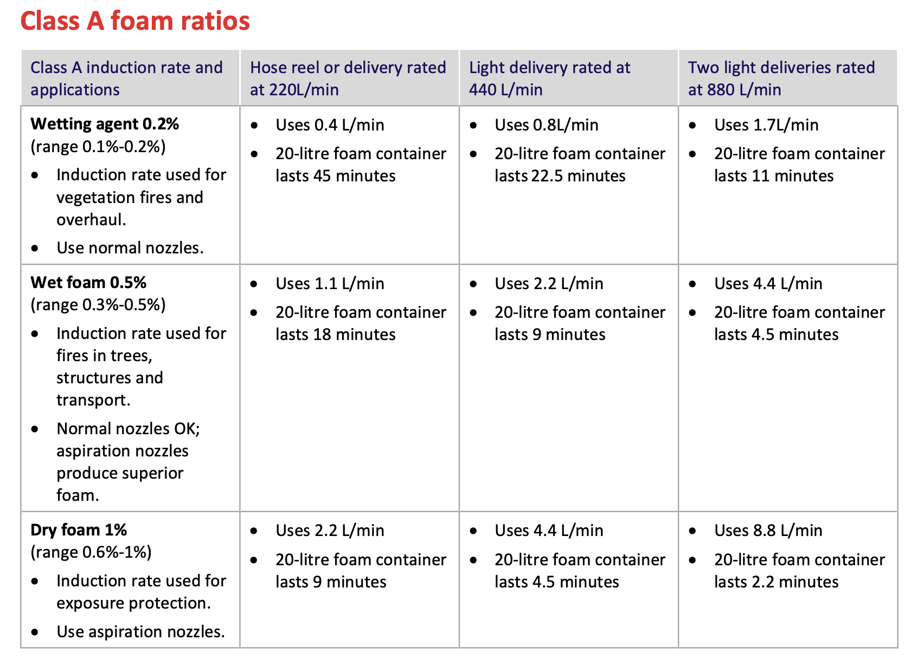

Slide 12
ความท้าทายและความเข้าใจผิด
“แค่น้ำมีฟอง” – ประเมินคุณสมบัติการซึมลึกและการยึดเกาะของโฟมต่ำเกินไป
ความกังวลด้านสิ่งแวดล้อม – แม้โฟมหลายชนิดจะย่อยสลายได้และปราศจาก PFAS แต่ก็ยังมีความกังวลอยู่ไม่ได้ผ
หากไม่มีการฝึกอบรมระบบ – CAFS และเครื่องกำหนดอัตราส่วนต้องการการบำรุงรักษาและความเข้าใจจากผู้ปฏิบัติงานอย่างสม่ำเสมอ
“โฟมแก้ปัญหาทุกอย่างได้” – โฟมช่วยเสริมกลยุทธ์ แต่ไม่สามารถแทนที่การตัดสินใจที่ดีได้
การผสมไม่ใช่เรื่องง่ายเสมอไป – อัตราการใช้ขึ้นอยู่กับชนิดเชื้อเพลิง หัวฉีด และวิธีการใช้งาน
ถูกมองว่าเป็น ‘ทางเลือก’ โดยบางทีม – ใช้น้อยเนื่องจากความเคยชิน ขาดการเปิดเผย หรือความคุ้นเคยกับอุปกรณ์
Notes:
“Let’s unpack some of the persistent challenges and myths we see with Class A foam.
The first is the classic: ‘It’s just water with bubbles.’ That sells it way short. Class A foam changes the physical properties of water—it clings, penetrates deep into fuels, and forms a heat-reflective barrier. It’s a chemical enhancer, not just a visual effect.
Then there’s eco-hesitancy. While it’s true that environmental concerns are valid—especially with Class B foams—most modern Class A foams are fluorine-free, biodegradable, and designed with environmental safety in mind. Education on product composition helps crews feel more confident using them.
Another big one is operator proficiency. CAFS and proportioning systems like FoamPro aren’t plug-and-play. If crews haven’t trained with them or if the system isn’t maintained, your foam won’t deliver the benefits it’s supposed to.
And we’ve all heard this one: ‘Foam will fix it.’ Foam boosts tactical effectiveness—it doesn’t replace it. If your strategy’s off, foam won’t save the day. It’s a powerful tool, but only as good as the tactics behind it.
Mixing ratios are another stumbling block. Whether you’re doing direct attack, mop-up, or exposure protection, the ratio changes—and those differences matter. Crews need to understand how mix rate affects foam performance.
Lastly, foam is often seen as ‘optional’ or an afterthought. This is sometimes a cultural or training issue—crews who’ve never had foam as part of their default setup may not instinctively reach for it. We’ve got to build that familiarity and trust through training and seeing real results on the fireground.”

Slide 13
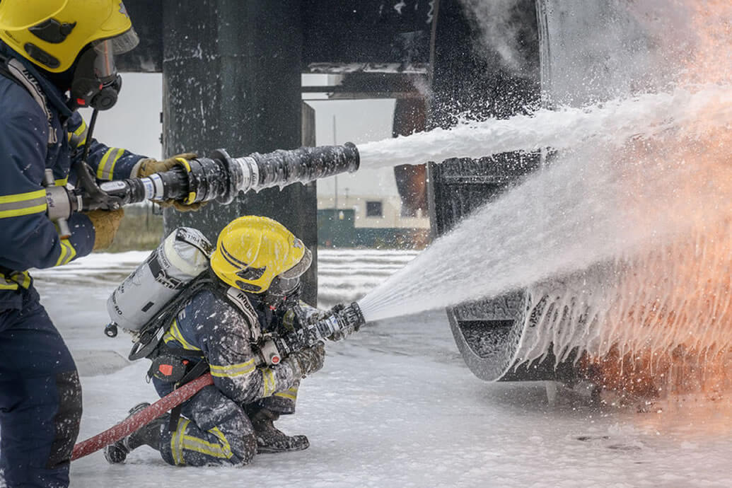
การใช้งานจำกัด: ความเสี่ยงต่อชีวิตในไฟจากของเหลวไวไฟ
โฟมประเภท A อาจใช้ในกรณีช่วยชีวิตที่เกี่ยวข้องกับของเหลวไวไฟ
อาจช่วยลดเพลิงชั่วคราวหรือเพิ่มทัศนวิสัยเพื่อการเข้าถึงอย่างรวดเร็ว
ควรใช้เฉพาะเมื่อโฟมประเภท B ไม่สามารถใช้ได้หรือไม่เหมาะสม
ไม่ใช่ตัวแทนโฟมประเภท B – ประสิทธิภาพในการยับยั้งไอของของเหลวไวไฟต่ำ
ต้องใช้สารดับเพลิงที่เหมาะสมตามมา
ใช้อย่างระมัดระวังอย่างยิ่ง และใช้เฉพาะในสถานการณ์ฉุกเฉินที่เสี่ยงต่อชีวิตเท่านั้น
Notes:
“Let’s be clear — Class A foam is not designed for flammable liquid fires, which are Class B. It doesn’t have the chemical properties to form a vapour-sealing film like Class B foams do.
That said, there are very specific situations where you might use Class A foam temporarily, (SNAP RESCUE) and that’s usually in an emergency where life is at risk and Class B foam isn’t available. For example, you might have a fuel spill under a vehicle after a crash, or a small hydrocarbon fire in a remote area. In those cases, some Class A foams can be used at 1% for knockdown — but only for small-scale surface fires, and only to buy time.
One of the key limitations is that Class A foam doesn’t suppress vapours. So once that foam layer breaks down — and it will — the reignition risk remains high. That makes it unsuitable for full suppression of flammable liquid incidents.
It’s important that crews understand the difference. Using Class A foam on a bulk fuel fire, thinking it’ll act like AFFF, is dangerous. But when used tactically, in a limited scope, and for the right reasons — it can support a rescue or contain a hazard until the right agent arrives.
So the takeaway here is: know the limits, and make sure any use of Class A foam on liquid fuel is part of a clearly understood, short-term strategy — not a replacement for proper Class B tactics.”

Slide 14
ข้อสรุปสำคัญ
โฟมประเภท A ช่วยเสริมประสิทธิภาพของน้ำ – ช่วยให้น้ำซึมลึกขึ้น ยึดเกาะดีขึ้น และเย็นเร็วขึ้น
เพิ่มความปลอดภัยและประสิทธิภาพ – ดับไฟเร็วขึ้น ใช้น้ำน้อยลง และลดความเหนื่อยล้าของเจ้าหน้าที่ดับเพลิง
หลากหลายและมีประสิทธิผล – ใช้ได้ทั้งไฟป่า ไฟโครงสร้าง ไฟขยะและยาง การเก็บกวาดหลังเพลิง และการป้องกันพื้นที่ใกล้เคียง
การใช้งานสำคัญ – อัตราส่วนผสม วิธีการ และการฝึกอบรมที่ถูกต้องเป็นสิ่งสำคัญ
ไม่ใช่ทางแก้ไขวิเศษ – โฟมช่วยเสริมกลยุทธ์ที่ดี แต่ไม่สามารถแทนที่ได้
ปลอดภัยต่อสิ่งแวดล้อมมากขึ้น – โฟมประเภท A สมัยใหม่ เช่น Ansul ย่อยสลายได้และปลอดสารฟลูออรีน

Slide 15
มีคำถามอะไรไหมครับ?
ขอบคุณสำหรับความสนใจครับ
เปิดโอกาสสำหรับคำถามหรือการแลกเปลี่ยนความคิดเห็น
ยินดีติดต่อสอบถามหรือพูดคุยเพิ่มเติมหลังจบการบรรยายได้เสมอครับ

